Slide 1

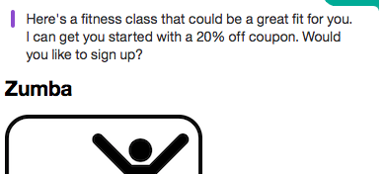

DEMO – Predictive Chatbot for Fitness Club USA
WOW Card
Use Case: This predictive chatbot gives personalized fitness class recommendations for members of the gym chain Fitness Club USA. Applications infused with predictive and conversational capabilities provide companies a way to enhance their customer experience.
Who
WOW
Persona(s) | Business Problem Statement(s)
Data Scientist | Difficulty building and deploying production-ready ML
App Developer | Difficulty building web applications with conversational and ML capabilities
Customer Service | Under high pressure handling heavy volume of customer interactions
Marketing | Low promotional offer response due to lack of personalization
Industry Application: Various, Retail & Distribution
Business Value
Fitness Club USA can get achieve ROI quickly by building a Cognitive Fitness Buddy on the IBM Cloud platform. This app can drive cross-sell opportunities by recommending fitness classes to members, as well as enhance the overall customer experience by providing a personalized interface for customers across multiple channels of interaction.
What
How
Use Case Overview
This demo walks through building a predictive chatbot application on IBM Cloud. The best way to start the demo is by showcasing the end application (for the “wow factor", then walking through how the demo was built. We quickly build a fitness class recommendation predictive model from a dataset with DSX’s model builder, then deploying it to WML to a RESTful API . Then we show how Watson Conversation service can be used to build a conversational flow, also employable via RESTful API. Node-RED is the GUI-based web app “glue” that provides the logic and connects these RESTful services. We enhance the app with two more IBM Cloud Services, Watson Tone Analyzer and the Twilio API.
Implementation
Demo Highlights:
Demo Components: Watson Machine Learning, Data Science Experience, Watson Conversation API, Cloudant, Watson Tone Analyzer API, Node-RED, Twilio API
Author(s): Sam Ennis
Internal Only : Yes BP Facing: Yes Customer Facing: Yes

